Slide 1
Blog Project UI/UX
Pages : Main(before login, after login), Login, Sign Up, Blog, Board, Chat, Profile
Components : Header, Footer, Navigator, Introduction, Login Form, Sign Up Form, Blog Creation Form

Slide 2
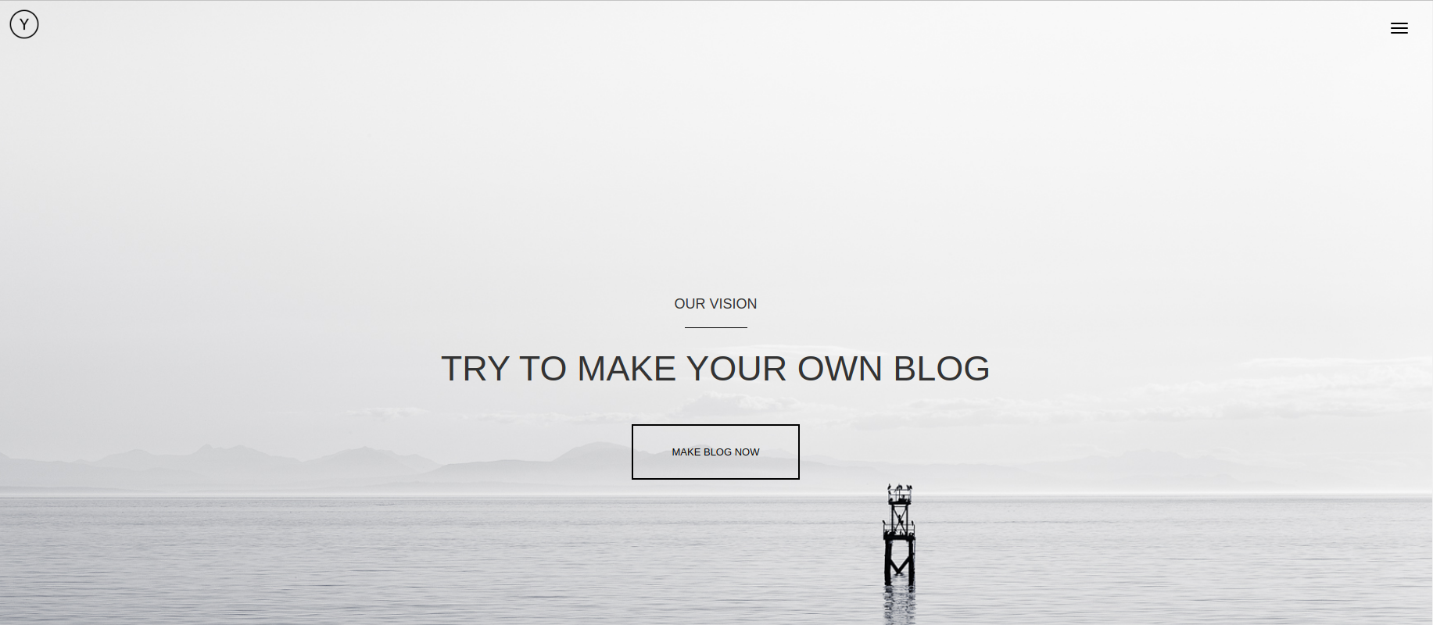
Main(1)

Slide 3
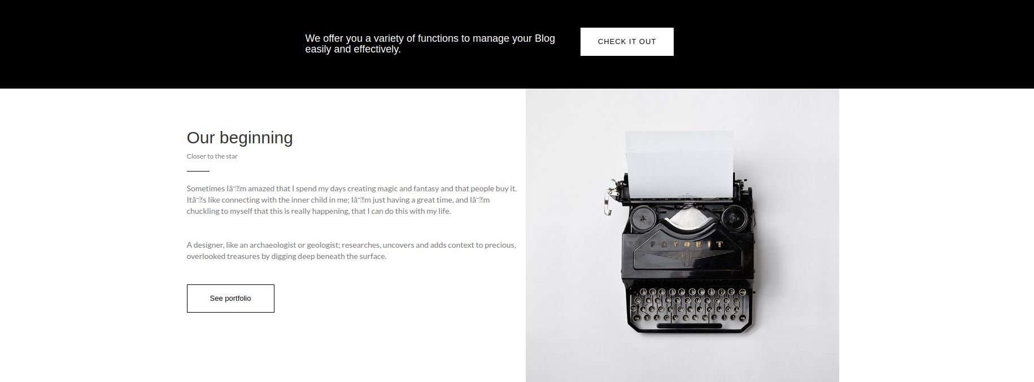
Main(2)

Slide 4

Main(3)

Slide 5
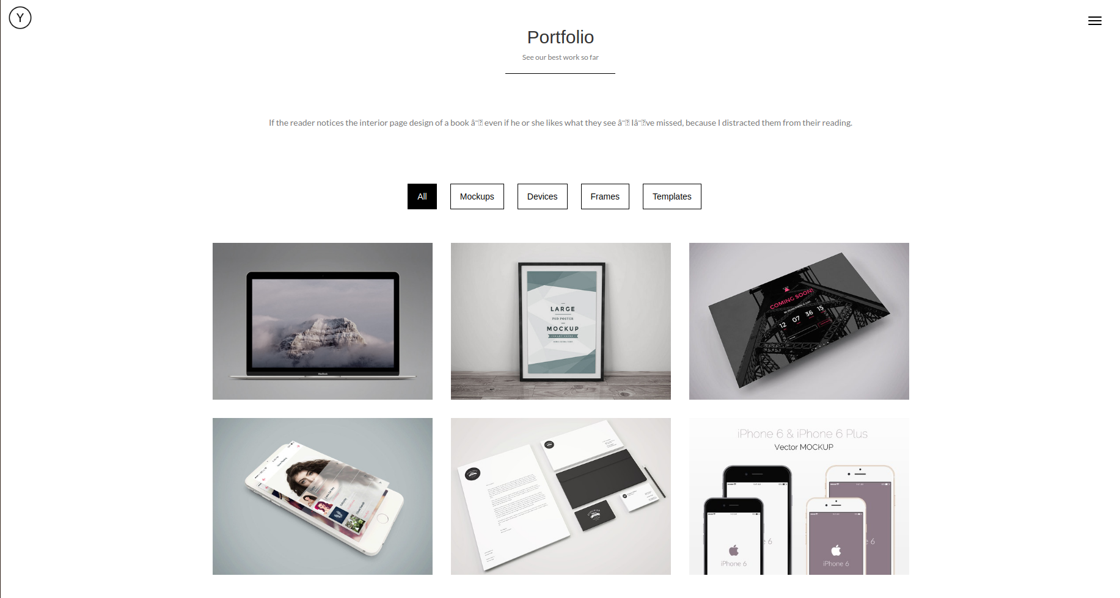
Main(4)

Slide 6
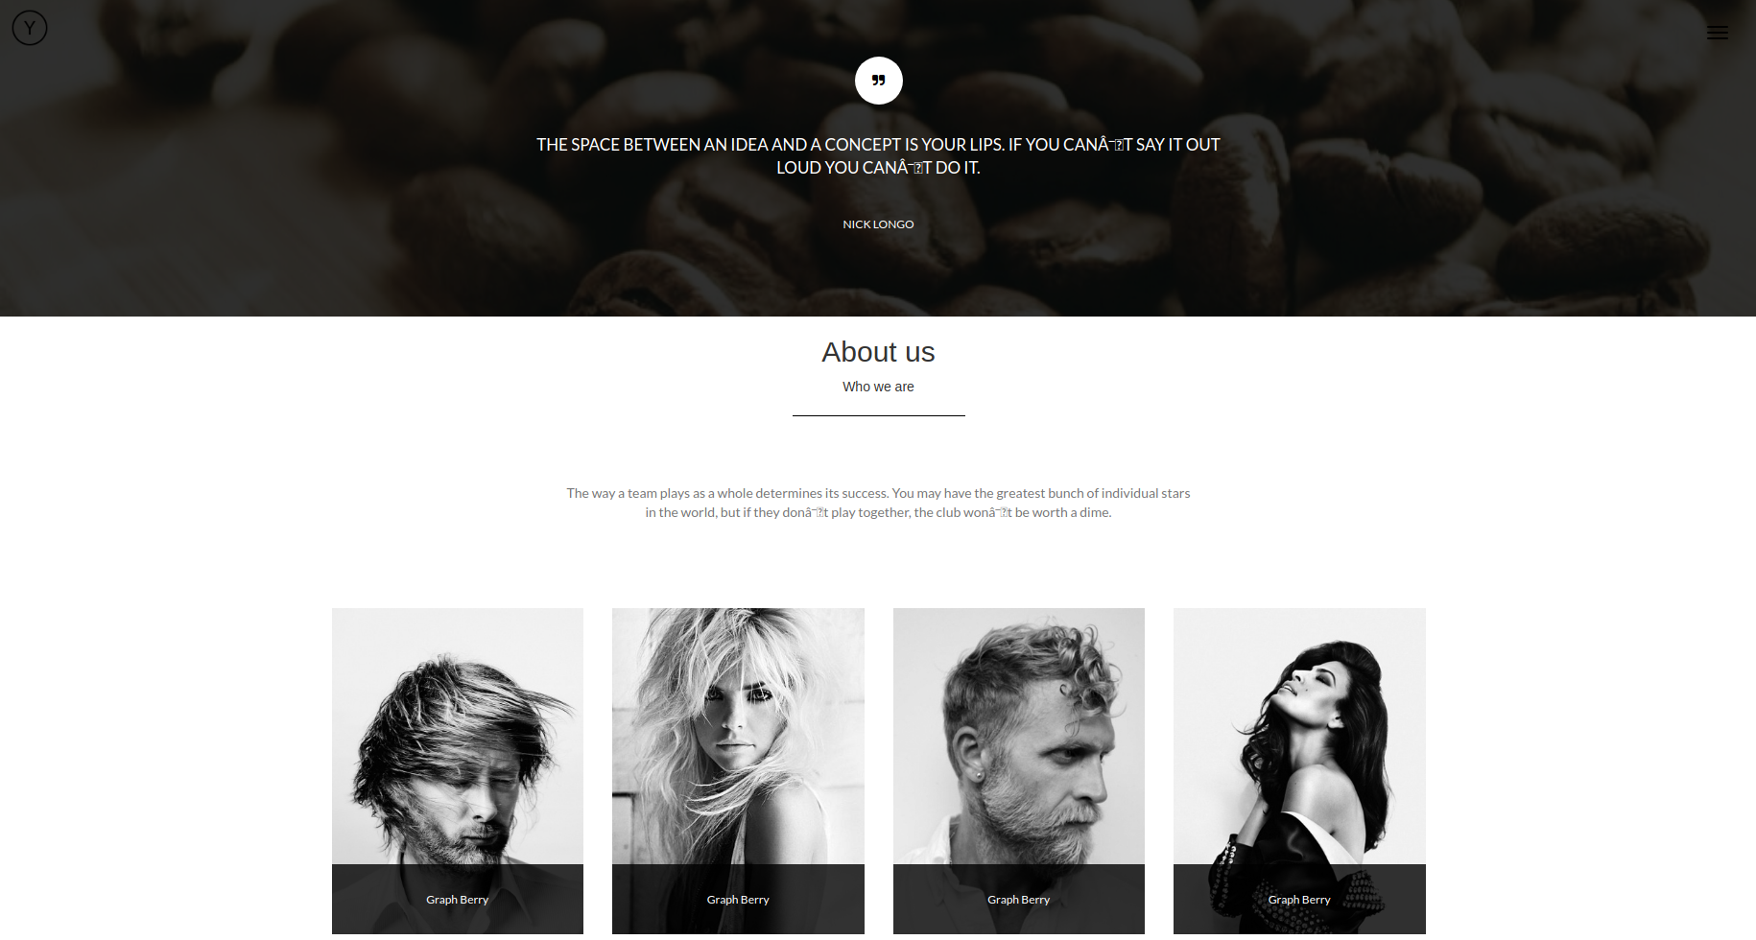
Main(5)

Slide 7
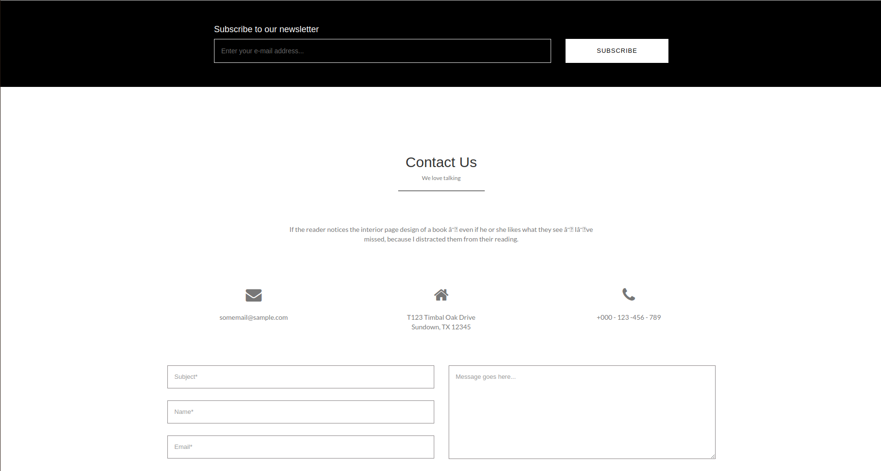
Main(6)

Slide 8
Login

Slide 9
Main

Slide 10
Main

